Slide 1
Civil Plan With Conduit Layout
Course: Computer Aided Design & Drafting
Faculty: Sumaiya Umme Hani

Slide 2
Presented by:-
Name: Nafinur Leo
Id: 20-42195-1
Section: J
Serial Number: 24

Slide 3
Overview:-
Steps Of Designing Civil Plan
Civil Plan
Fittings And Fixture
Fittings And Fixture Layout
Conduit Layout
Conduit Layout with Generator

Slide 4
Steps Of Designing Civil Plan:-
AutoCAD file setup
File name (.dwg)
Status bar
Drawing all brick line using solid line
Offset
Filet and Trim
Stair
Dimension and Text

Slide 5
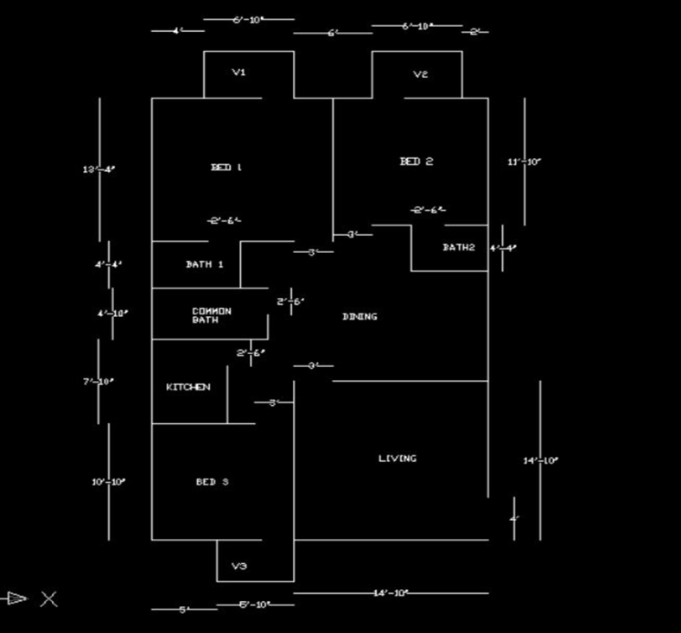
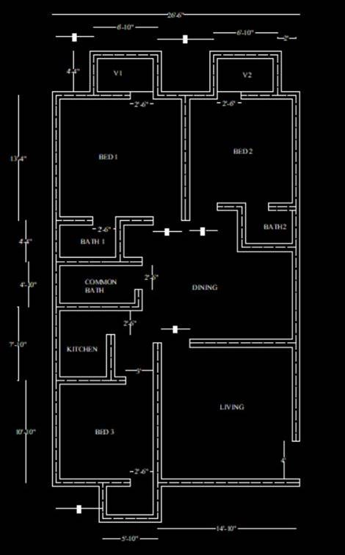
Civil Plan:-
Brick Line Design
Interior And Exterior Design

Slide 6
Fittings And Fixture:-
Switchboards – SB
Light – L
One Kind Of Light – K
Tube Light –T
Fan – F
Exhaust Fan – EF
Television – TV
Refrigerator – REF
Air Conditioner – AC
2 Pin Socket – 2S
3 Pin Socket – 3S
Sub Distribution Board – SDB
Main Distribution Board – MDB

Slide 7
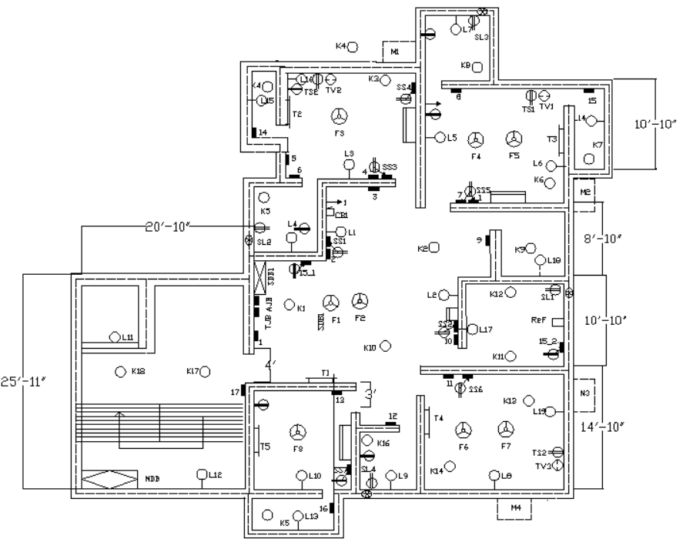
Fittings And Fixture Layout:-

Slide 8
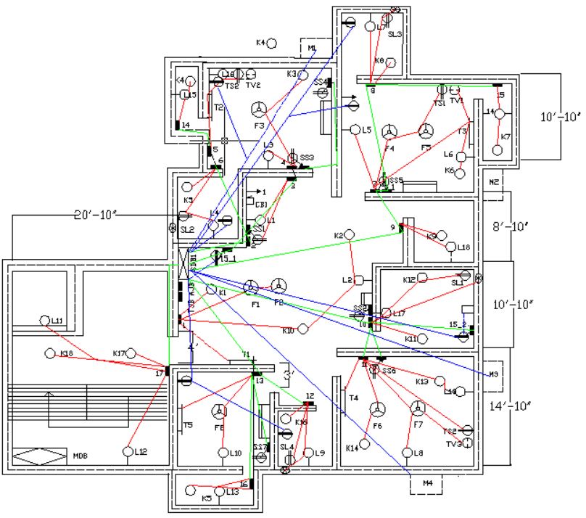
Conduit Layout:-

Slide 9
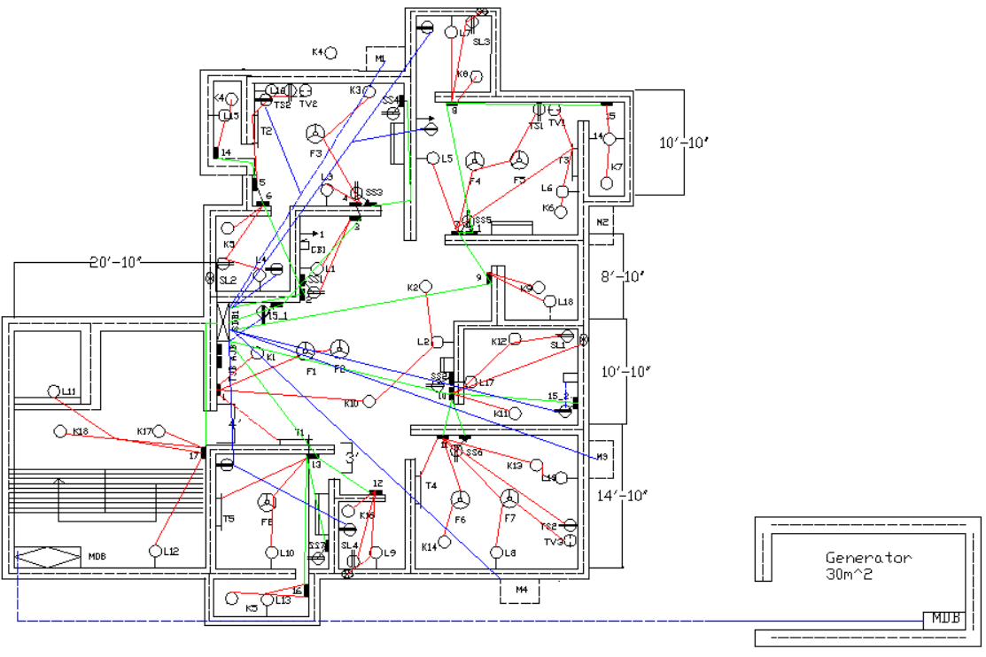
Conduit Layout with Generator:-

Slide 10
Thank You

